Slide 1

Welcome
Intro to Agile Dev

Slide 2
Prerequisites
This course assumes you:
Are interested in learning more about the Agile development methodology

Slide 3
Why study this subject?
Agile is a VERY common methodology used in modern software engineering
Familiarizing yourself with the theory and practice of Agile positions you well for contributing to the team and its goals

Slide 4
My pledge to you
I will...
Make this interactive
Ask you questions
Ensure everyone can speak
Use an on-screen timer

Slide 5
Objectives
At the end of this course you will be able to:
Speak to the specifics of the Agile development methodology
Talk about how the methodology can benefit modern software engineering practices

Slide 6
Agenda
Software development methodologies and iterative software development
Software Development Lifecycle (SDLC)
The Agile Manifesto and best practices in Agile/Scrum
Working with JIRA

Slide 7
Software Development Methodologies and Iterative Software Development

Slide 8
Common Approaches to Software Development
Waterfall
Iterative

Slide 9
Waterfall Software Development
A sequential development process that flows like a waterfall through all phases of a project (requirements, design, implementation, testing, and deployment for example), with each phase completely wrapping up before the next phase begins.
Key aspects:
Majority of research done up front
More accurate time estimates
More predictable release date
Cons:
Process is brittle – can’t pivot easily in terms of changing requirements
Long lead times – difficult to respond to rapid business evolution
Tools:
Commonly use Gantt charts to track projects, subtasks and dependencies

Slide 10
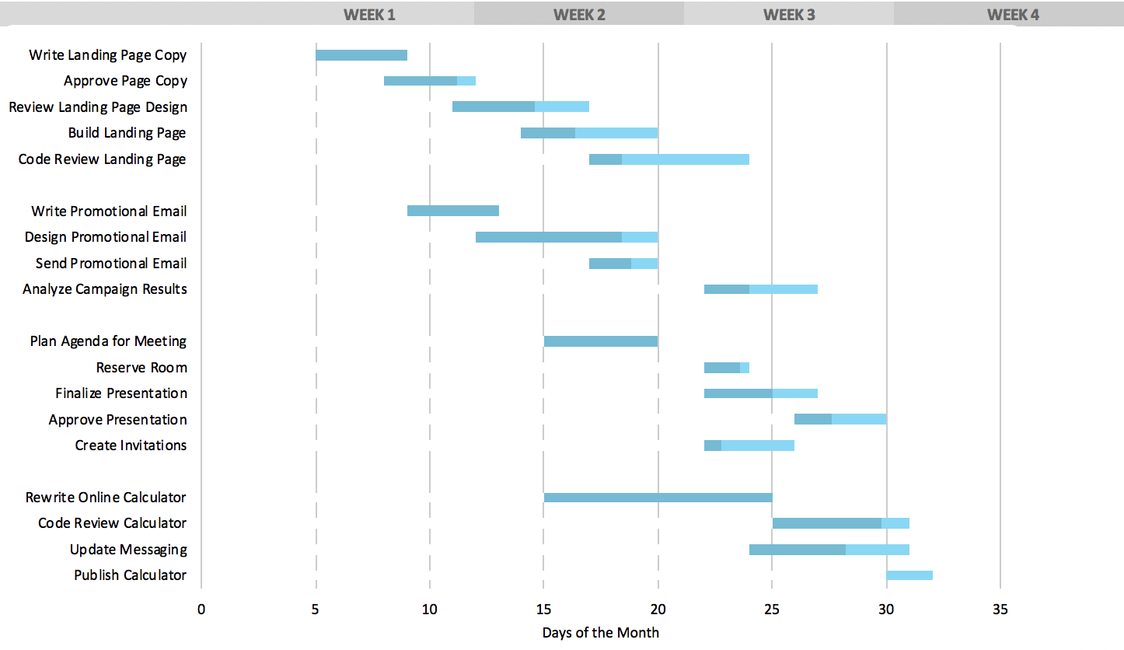
Typical Gantt Chart

Slide 11
Agile Software Development
A group of software development methodologies based on iterative development.
Requirements and solutions evolve through collaboration between self-organizing cross-functional teams.
Key aspects:
Incremental delivery
Always ready to ship
Continuous inspection of work product and process provides feedback for continuous improvement
We will explore Agile in more detail later in this class

Slide 12
Iterative Software Development
Key elements:
Incremental improvement to code and process
Always ready to ship
Iterative feature development
Working with the Product Owner
Pivoting mid-development

Slide 13
Incremental improvement to code and process
Principle: Using feedback obtained from regular examination of product and process lets you incrementally improve both
Key aspects:
Work in short cycles (1-6 weeks) composed of overlapping phases: requirements, design, programming, testing.
Build on what was built before and produce a working product at each stage. Gather customer feedback at the end of each iteration.
Each iteration, evaluate the team’s performance. Change internal process as needed to improve quality of estimation and delivery.

Slide 14
Always ready to ship
Principle: after the first iteration, the product is always "ready to ship". That is, the product does something useful and is in a releasable state.
Key aspects:
This is a risk mitigator – if the project is cancelled or greatly reduces in scope, there is still something of value to show for the work efforts
Projects are less likely to be cancelled, as there is always a working product that shows the project’s value and the team’s competence
Key practices that support this principle:
Do daily software builds
Fix bugs right away
Relentlessly use automated testing to mitigate regression

Slide 15
Iterative Feature Development
Principle: Instead of building all features and then releasing (waterfall), develop one feature, then the next, always keeping the application in a shippable state. Continually re-assess priority of feature development, including refinement of existing features, based on feedback.
Key aspects:
Work closely with all concerned parties
All involved need to understand and appreciate that development on project will be iterative
Application reviewed at demo is still “work in progress”
Focus is on gathering “real-time” feedback so course corrections can be made if required
Key practices that support this principle:
Set expectations for all stakeholders
Educate stakeholders on iterative development so they are effective contributors
Be willing to change

Slide 16
Working with the Product Owner
Principle: working closely with the Product Owner enables the incremental production of shippable features that are valuable to the end user
Key aspects:
Consult with the product owner before each iteration, agreeing on the scope and details of work for that iteration.
During the iteration, the external customer or project manager cannot change the scope for that iteration, but the development team may change the scope by dropping features if the end date will not be met.

Slide 17
Pivoting mid-development
Principle: An agile, iterative process can allow a project to pivot in small or large degree, mid-process, without excessive cost of time or resources
Key aspects:
Manage to meet business goals, due dates and budgets. Be willing to change requirements to fit these, not the other way around.
Learn as you go; be adaptable to new or changing business needs that become clear only after development begins.
Analyze existing implementations frequently to determine that they are meeting business goals.

Slide 18
Software Development Lifecyle (SDLC)

Slide 19
Software Development Lifecycle (SDLC)
Release
Plan
Operate
Test
Develop
Feedback

Slide 20
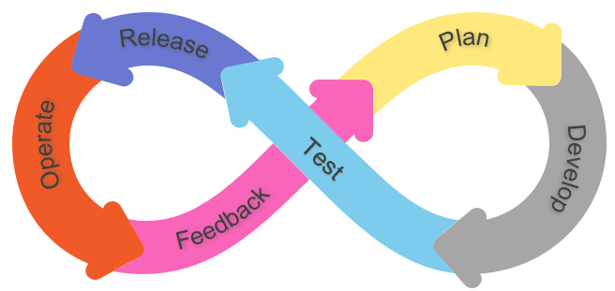
Plan Phase
Focus:
Deciding on the set of user stories for team focus over the upcoming iteration
Refining those stories to ensure all required detail to complete is in place
Identifying key requirements (both functional and Quality of Service) that need to be met
Notes:
Requirements definition at this stage should include things like security requirements (threat modeling, test needed to shift security left)

Slide 21
Develop Phase
Focus:
Executing coding tasks that will complete the set of user stories in scope for the iteration
Implementing automated unit tests that can continue to confirm requirements met
Addressing any potential security vulnerabilities in the code being built
Ensuring the full body of source code created to date (including new code) remains “clean”
Ensuring new code gets correctly merged with existing code and code added by other members of team
Notes:
Clean code – means code that is easier to read, easier to test, easier to maintain long-term; can include refactoring (seeking to improve internal structure of code without impacting external operation). Extracting methods, renaming, reuse, etc.

Slide 22
Test Phase
Focus:
Code updates from all team members built as a single, comprehensive unit
Seeks to validate that all the code operates correctly together
Through automated integration tests, verifies requirements successfully satisfied
Likely includes deployment to pre-production environments for testing
Can include automated security scans as well to help find security vulnerabilities early

Slide 23
Release Phase
Focus:
Installing required runtime, compiled binaries, and configuration to the production environment
May include small set of “smoke tests” (test transactions that can be run through the system to validate at a macro level)
Verification that all infrastructure and configuration is in place for user access
Ensuring that required documentation is up-to-date for production support

Slide 24
Operate Phase
Focus:
Ensuring that the application remains healthy in production
Addressing any production incidents encountered during application operation
Identifying and tracking any issues/bugs that need to be elevated from “incident” to “problem” status
Notes:
Incident – single (or discrete number of occurrences); may be able to execute a workaround for immediate relief
Problem – something more endemic that will likely require a code fix
Incident status is first sign of issues and can elevate to problem

Slide 25
Feedback Phase
Focus:
Gathering business stakeholder, technology stakeholder, and user feedback on how application is operating post deployment of most recent iteration (and overall)
Can include explicit demo to project team as part of closing out current sprint
Goal is uncovering opportunities to continuously improve the product and getting those opportunities documented for inclusion in future sprints

Slide 26
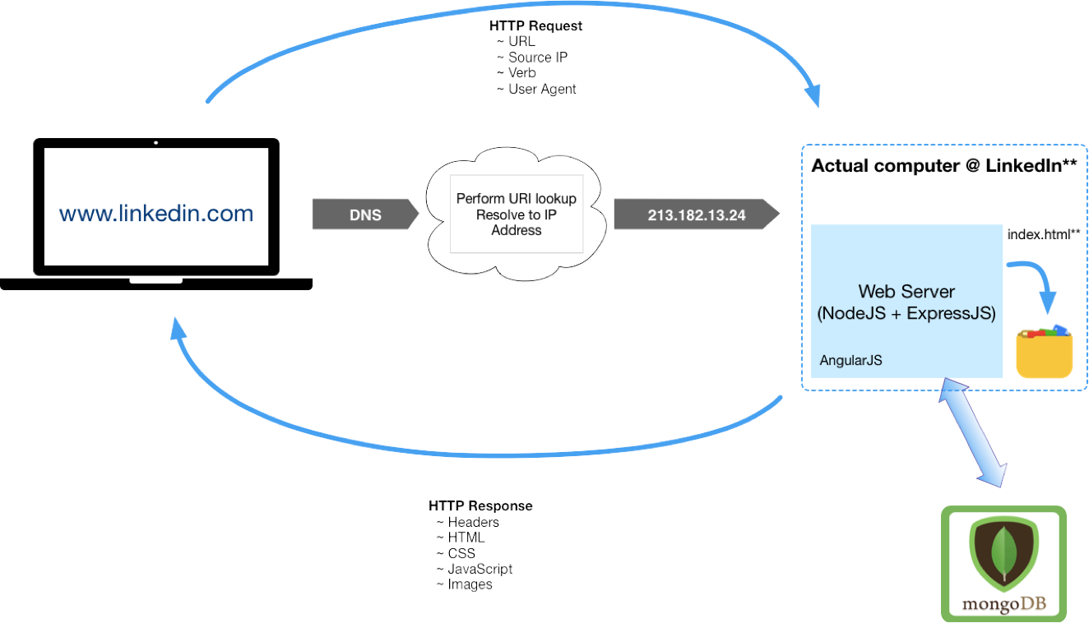
Elements of a Full-Stack App and HTTP Request/Response Cycle
Actual computer running app
www.theapp.com
Front-end framework

Slide 27
WORKSHOP:
Group discussion considering the Reference Implementation from the following points of view:
Itemize the set of high-level features that will be needed to implement this application?
Which features should be implemented first? Which features should ship first?
How might your approach need to pivot, based on market or other factors?
Looking at the “Reference Implementation” from an iterative approach
Notes:
Walk through the scenario with the students

Slide 28
WORKSHOP:
Group discussion considering the Reference Implementation from the following points of view:
Based on your prioritization of the features that should be implemented/shipped first (from the previous discussion), what should your first two iterations look like?
Include tasks for each phase (Plan, Develop, Test, Release, Operate)
What are some practical ways to gather feedback on the features deployed as part of the first two iterations?
Looking at the “Reference Implementation” from an iterative approach

Slide 29
The Agile Manifesto and Best Practices

Slide 30
The Agile Manifesto and its Origins
What is it? A statement of values regarding approaches to how teams create and ship software
When was it made? 2001, by 17 top software developers and consultants
Key aspects:
12 values were agreed upon
These values are NOT a process, implementation or standard; they are opinions
Many popular project management methodologies have arisen that are based on these values
Many Agile implementations are poorly executed; it takes great cooperation between business leadership and a competent, self-guided dev team to make it work

Slide 31

Agile Values
Individuals & Interactions
Processes & Tools
Working Software
Comprehensive Documentation
Customer Collaboration
Contract Negotiation
Responding to Change
Following a Plan

Slide 32
Key Elements of the Agile Approach
The Agile method is an iterative and incremental tactic to software design that utilizes constant planning, understanding, upgrading, team partnership, development, and delivery.
It is driven by the principles of providing value and collaborating with stakeholders.
It starts with customers defining the end uses of the final product and the kind of problems the final product attempts to address.
Designated teams start to plan and work on a complete process through planning, implementing, and appraising.
Since the development process is iterative, errors are resolved in the intermediate stage of the project.

Slide 33
Modern Approaches to Agile Software Development
Several project management approaches implement Agile values in some way. Often, they bring in elements of other approaches.
Popular methodologies:
Kanban
Uses visual boards to view & organize tasks
Uses elements of “just in time” lean manufacturing strategies
Scrum
Aligns closely with Agile values
Breaks down product development into iterative sprints
Scaled Agile Framework (SAFe)
Workflow and organizational patterns to help deploy Agile at scale
Can support large organizations
Emphasizes throughput
Makes use of exclusive roles (“Scrum Lead”, “Product Owner”)
Emphasizes constant communication

Slide 34
Common Agile Practices
Common practices are:
Close collaboration between an engaged and knowledgeable Product Owner and a self-organizing dev team with strong ownership for code and team quality
Relentlessly working to break complex tasks down into smaller, more discrete and defined elements
Making use of Scrum boards to track and prioritize work
Sprints run using Scrum principles and practices
Continuously evaluate and improve how we choose scope of work for each iteration

Slide 35
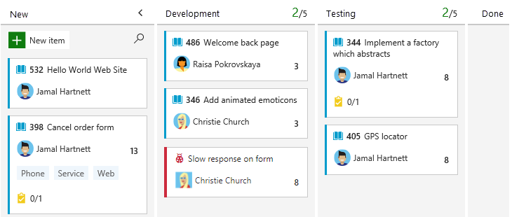
Typical Kanban Board

Slide 36
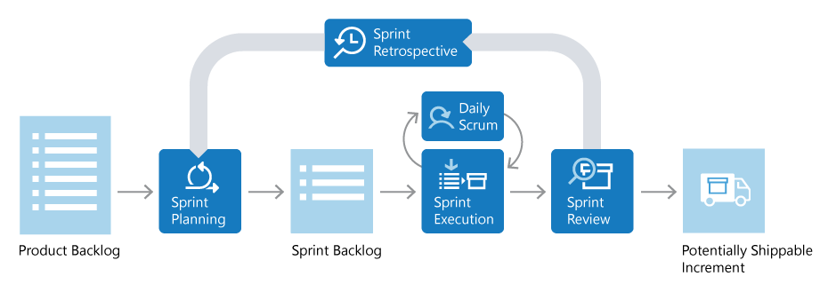
Diagram of Typical Scrum Sprint
Source: https://docs.microsoft.com/en-us/devops/plan/what-is-scrum

Slide 37
Scrum Roles
Product Owner
Scrum Lead
Scrum Team

Slide 38
Scrum Roles
Product Owner
Responsible for what team builds and why
Keeps backlog up to date and in correct priority order
Scrum Lead
Scrum Team

Slide 39
Scrum Roles
Product Owner
Ensures that Scrum process is followed by team
Responsible for the fidelity of the process
Part coach, part team member, part cheerleader
Scrum Lead
Scrum Team

Slide 40
Scrum Roles
Product Owner
Scrum Lead
Scrum Team
People building the product
Responsible for product build (and associated quality)

Slide 41

Product Backlog
Prioritized list of work the team will deliver
Product owner manages – adds, changes, reprioritizes as needed
Items at the “top of the list” get worked first

Slide 42

Backlog Grooming
Regular team activity which allows group to verify that quality of defined sprint items remains high
Team discusses each item and ensures that all required information to successfully complete is in place
For example, has the item been given an adequate description and does the acceptance criteria provide team members with the information needed to assess “done”?
Backlog item is assigned “points” representing relative level of effort to complete
Points are not directly correlated to hours – instead, about amount of effort required for the task in comparison to previous tasks completed or other tasks planned
There will likely be some number of points for items that is considered “too high” to complete as a single item
Provides threshold for determining when to divide a large task into smaller parts
Notes:
Will talk in more depth about characteristics of sprint items/cards in the section on Jira
One common pointing system used is Fibonacci (but not only approach)
Team can also use techniques like “planning poker” (https://www.planningpoker.com/) to help ensure objective pointing (minimize effect points assigned by another team have on your own)

Slide 43

Sprint Planning
Team chooses items from the backlog to target for upcoming sprint (based on prioritization by Product Owner)
Intended to represent amount of work team thinks they can complete within the sprint
Items in the sprint may be broken down into a set of more granular tasks
Historical data from previous sprints can help a team determine its velocity (i.e., how many points the team can complete in an iteration)
Results in a “line” for the sprint within the backlog – items above the line are “in”, everything else is pushed to future iteration
If something below the line needs to move above, it will need to be swapped with an existing task to ensure capacity to deliver

Slide 44

Sprint Execution
Team executes on the items identified for inclusion in the iteration
Short daily meetings are held among team members (called daily Scrums) – usually no more than 15 minutes
Each member briefly describes what they worked on the previous day, what they’re planning to work on today, and any “blockers” (issues preventing progress)
As part of daily review, a sprint burndown chart can be used to assess whether or not the team is on track to complete what was committed to

Slide 45

Sprint Review
At the end of the iteration, team demonstrates for stakeholders what’s been accomplished during the sprint
Goal is to show incremental value

Slide 46

Sprint Retrospective
Team reflects on what went well during the last sprint
Just as important (if not more so) is identifying specific areas for improvement to take into future sprints
Outcome should include a set of action items to help steward improvement

Slide 47
Team Reflection
Discuss the following questions as a group.
Which of the sprint activities do you feel would be the easiest to complete, and why?
Which of the sprint activities do you feel would be most difficult, and why?
Which of the sprint activities would you consider to be the most important, and why?

Slide 48
WORKSHOP:
Using information gathered during the previous discussion, work as a group to build your Team Definition. Team Definition represents the team’s working agreement. Go through each activity executed during a sprint and set expectations for how your team will perform and ensure ongoing fidelity of each ceremony.
Building the Team Definition

Slide 49
Knowledge Check
This role is ultimately responsible for ensuring that all scrum ceremonies are correctly followed:
Scrum team
Product owner
Team leader
Scrum lead
Enter the letter corresponding to your answer in chat

Slide 50
Knowledge Check
True or False: Points assigned to sprint items should directly correspond with the number of hours the task is expected to take to complete.
Enter your answer in chat

Slide 51
Knowledge Check
This role is ultimately responsible for keeping the backlog up to date and in correct priority order:
Scrum team
Product owner
Team leader
Scrum lead
Enter the letter corresponding to your answer in chat

Slide 52
Working with JIRA

Slide 53
Overview of Project and Issue Tracking Software
There are many applications in use to manage tech work – some oriented around service tickets; some around dev tasks, some around both
Popular project and issue tracking software:
JIRA
Asana
Trello
Monday
Zoho
There are MANY others; this is a crowded space. In dev work, integration with tools used in the full dev cycle is important – testing, deployment, monitoring, etc.

Slide 54
Overview of JIRA
JIRA is part of a family of products from Atlassian. It can be configured to align with popular Agile methodologies.
Key functionality:
Provides a central hub for design, coding, testing, collaboration, release, and maintenance
Integrates with CI/CD systems
Provides a feature backlog for planning purposes
Enables Sprint planning

Slide 55
Basic Building Blocks of JIRA
JIRA is built around three basic concepts:
Projects: A collection of Issues, all oriented to one product or work initiative
Issues: The basic element of work in JIRA. Includes the work to be done, as well as metadata about the work. This can be net new work, bug fixes, service tickets, etc. – any type of work
Workflow: A record of the life of an Issue. Issues can only have one state at a given time. Transitions from one state to another can be tracked and controlled as needed
Notes:
Supports concept of User Story (feature to be delivered), Spike (required research to determine approach), etc. Will review the various types as part of the demo.

Slide 56
DEMO:
Lifecycle of a JIRA Issue
Notes:
Ideally will use an instance of Jira set up in an AWS sandbox that all participants can access (including external instructors), and that team can work from for demo/labs.
Discuss creation of Epics (for grouping features), user stories (for defining features), spikes (for capturing research tasks). Review process of creating each type and the various pieces of metadata available for each type. Show assignment of issue to a sprint and how tracked on board. Demonstrate each.

Slide 57
Using a Scrum Board
Your Scrum board visually represents your workflow – the sequential state changes of your team’s work. A common configuration might be:
New Issues (in the form of features/stories/tasks/bugs, etc.) begin in a Product Backlog, as they are identified
In Sprint Planning, Issues are refined and moved into the Sprint Backlog
Whether assigned a work item, or pulling it yourself, the board lets you choose an Issue and move it through the states in the defined Workflow for the Project
Often, your actions in other tools will result in a state change for an Issue; the board will update to reflect that change
Because so much of the work activities is tracked electronically, you can also use JIRA’s Control Center to view important metrics about the work of the team and of its members. It tells you about things like: How long an issue sits in a state; average time to complete an Issue; etc.

Slide 58
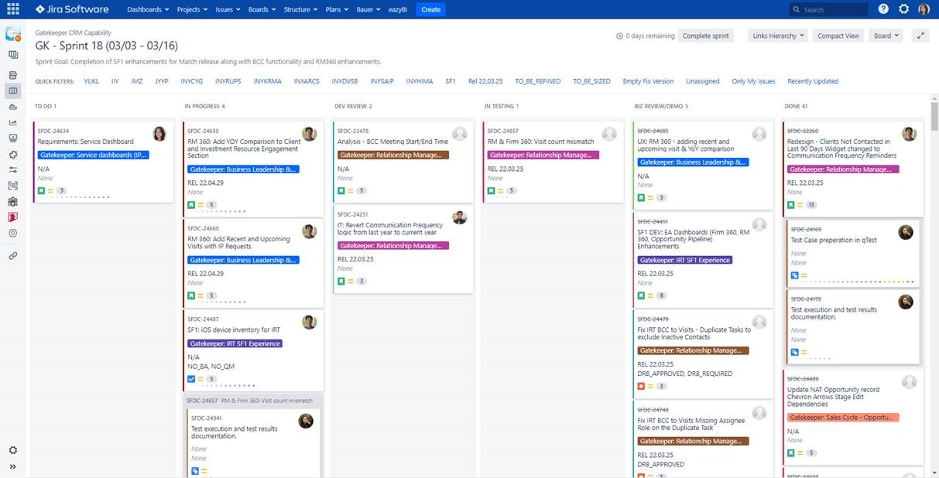
Example Scrum Board

Slide 59
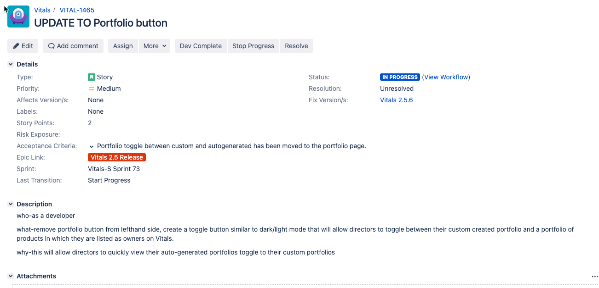
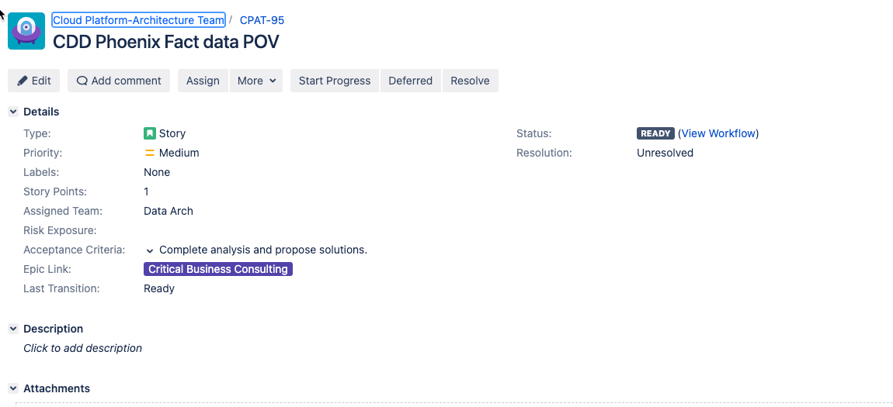
Team Activity – Story Review
Review the two stories displayed here – what are some key differences you see between the two? Which of the two do you think is better structured, and why? For the one less structured, how might you go about correcting it?
Discuss as a group and share your thoughts.

Slide 60
LAB:
Story description: As a customer of the online ordering system, I want to be able to add new items to my shopping cart, update items already in the cart (e.g., adjust quantities), and remove items from the cart that I no longer wish to purchase so that I can effectively manage and submit an order.
Acceptance criteria: I can add a new item to the cart, I can update quantities on an item that is already in my cart, and I can remove items that I no longer wish to purchase.
Story Points: 13
As a team, create new stories that break this larger task down into more manageable “bites”. Include description, acceptance criteria, and estimate points for relative level of effort. Also, identify any additional concerns or edge cases that should be considered; capture that information in a card as well.
Breaking down a large story into smaller tasks
Notes:
For adds, what if I attempt to add an item already in the cart – what should happen?
For updates, what if I attempt to reduce quantity to 0 (or some invalid value like a negative number)?
For deletes, what if I remove the last item in my cart?
Walk through execution with the students.

Slide 61




Thank you!
If you have additional questions, please reach out to me at:
erik-gross@pluralsight.com

